Slide 1
Message Map Template
Rob Karel, Principal
GTM Perspective

Slide 2
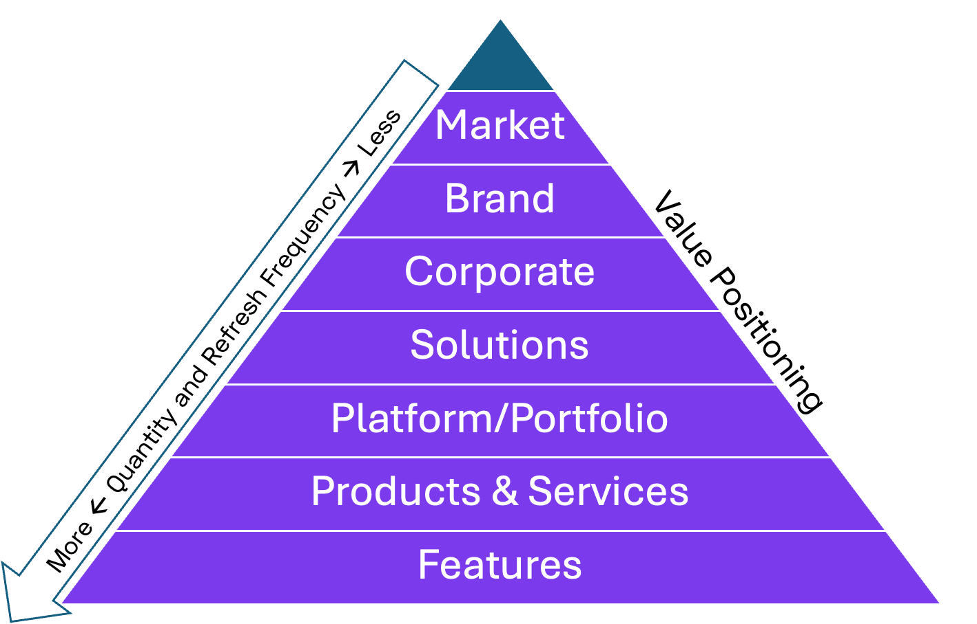
Layers of Messaging Architecture

Slide 3
Messaging for {Platform, Product, Solution, Launch…}
Market description: How would the market or a market analyst describe the value of this kind of solution?
Company value proposition message: {Elevator pitch for key problems solved and why company’s solution is differentiated and best positioned}
Target audience/personas: {What market segments, industries, personas, etc would be most interested and impacted}
Use Case 1 {High priority customer use case/process} | Use Case 2 | Use Case 3
Key customer challenges/pain points {Keeps customers up at night, but highlighting those where Company best suited to solve} | Key customer challenges/pain points | Key customer challenges/pain points
Most relevant Company differentiators {Distinctive, credible, easily provable, valuable} | Most relevant Company differentiators | Most relevant Company differentiators
Proof points {3rd party or data-centric validation (e.g., analysts, media, CSAT scores, Retention rates, etc} | Proof points | Proof points
Key Competitors: {Those stealing mindshare for this use case} | Key Competitors: | Key Competitors:
Customer case studies: {Specifically those solving this use case} | Customer case studies: | Customer case studies:

